Slide 1




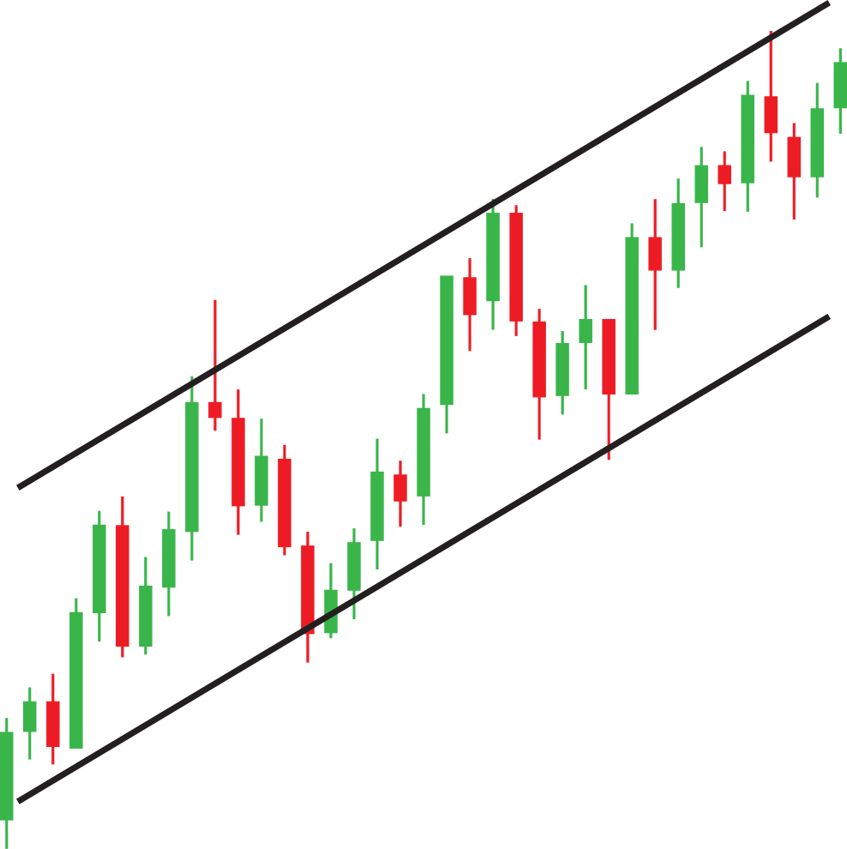
Predictive analysis of Stock Market
Soham Shelke - 23106044
Atharva Tawde - 23106122
Atharva Samant-23106057
Raunak Panigrahi - 23106092
Project Guide
Prof. Shraddha Dalvi
Academic year 2024-25
Notes:
<number>

Slide 2

INTRODUCTION:-
DOMAIN:- FINANCIAL MARKET ANALYSIS
TECHNOLOGY:- MACHINE LEARNING USING PYTHON
The stock market is a complex and dynamic system influenced by various factors, including economic indicators, market sentiment, and global events.
Predicting stock prices accurately is essential for investors, traders, and financial institutions to make informed decisions.
With advancements in machine learning, it is now possible to analyze large datasets, identify patterns, and make predictions with higher accuracy.
This project aims to utilize machine learning techniques to predict future stock prices based on historical data and relevant financial indicators.
Notes:
<number>

Slide 3

Objectives:
To Develop a machine learning model to predict stock prices based on historical data.
To Evaluate the performance of the model using various metrics such as accuracy and mean squared error.
To Compare the predictions with actual stock prices to assess the model's effectiveness.
Motivation:
Importance of Prediction: Accurate stock price predictions can lead to better investment decisions and risk management.
Technological Advancement: Leveraging machine learning for financial forecasting represents a cutting-edge approach in financial technology.
Practical Application: The project offers practical experience in applying machine learning to real-world financial data, enhancing both technical and analytical skills.
Notes:
<number>

Slide 4
Literature Survey Of Existing System
1. Stock Price Prediction using Machine Learning
Publisher: IEEE
Authors: B N Varaprasad; Ch. Kundan Kanth; G. Jeevan; Y.Kalyan
Chakravarti
Published in & by: 2022 International Conference on Electronics and
Renewable Systems (ICEARS)
2. Stock Market Prediction using Supervised Machine Learning Techniques
Publisher: IEEE
Published in & by: 2020 IEEE Asia-Pacific Conference on Computer
Science and Data Engineering (CSDE)
Authors:Zaharaddeen Karami Lawal; Hayati Yassin; Rufai Yusuf
Zakari
Notes:
<number>

Slide 5
3. Stock Market Prediction using Machine Learning Techniques
Publisher: IEEE
Published in & by: 2023 International Conference on Power,
Instrumentation, Control and Computing (PICC)
Authors: Aditi Gupta; Akansha; Khushboo Joshi; Madhu Patel;
.
4. Stock market prediction
Publisher: IEEE
Published in & by: 2015 19th International Conference on System Theory,
Control and Computing (ICSTCC)
Author: Radu Iacomin
5. Stock Price Prediction using Machine Learning and Deep Learning
Publisher: IEEE
Published in & by: 2021 IEEE Mysore Sub Section International Conference m
(MysuruCon)
Authors: Pratheeth S; Vishnu Prasad R

Slide 6

Problem Statement
The stock market is inherently volatile and influenced by numerous factors including economic indicators, market sentiment, and company performance.
Predicting stock prices accurately is a complex task due to the non-linear and dynamic nature of financial markets.

Slide 7
System Design Of Stock Prediction
Data Collection:
SOURCE:-Historical stock price data obtained from Kaggle.
FEATURES:-The Dataset includes attributes like opening price, closing price, high, low, volume, and date.
2. Data Preprocessing:
CLEANING:-Addressing missing values, removing outliers, and ensuring data consistency.
FEATURES:-Creating additional features such as moving averages, stock returns, and trend indicators to enhance predictive accuracy.
NORMALIZATION:-Scaling features to maintain consistency and ensure effective model training.
3. Model Training:
LINEAR REGRESSION:- Implemented to predict future stock prices based on historical and engineered features.
TRAINING AND TESTING:-The dataset is split into training and testing sets to evaluate the model's performance.
Notes:
<number>

Slide 8






4. Model Evaluation:
METRICES:- Evaluating the model using Mean Squared Error (MSE) and R-squared value to measure accuracy.
VALIDATION:-Cross-validation is employed to ensure the model's robustness and its ability to generalize to new data.
5. Prediction:
OUTPUT:-Generating predictions for future stock prices and comparing them with actual market data to assess accuracy.

Slide 9
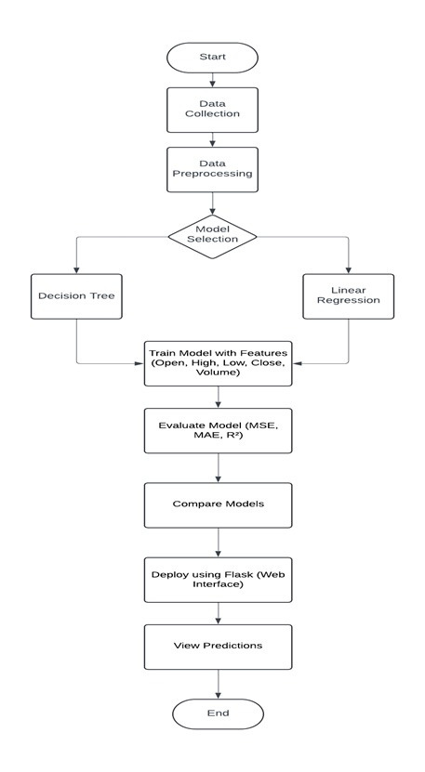

Slide 10
Technologies and Methodologies:
Hardware:
Jupyter Notebook: As IDE.
Minimum Laptop Specifications for Stock Price Prediction:
Processor: Intel Core i5 (8th gen) / AMD Ryzen 5
RAM: 8 GB (minimum), 16 GB recommended
Storage: 256 GB SSD
OS: Windows 10/11 or Ubuntu Linux
Battery: 6-8 hours
Screen Size: 13-15 inches
Connectivity: USB 3.0/Type-C, Wi-Fi 5
Software:
Programming languages: Python 3.0
Frameworks: Flask
Notes:
<number>

Slide 11
Linear Regression
Definition:A method to predict a value (like stock price) using a straight line to show the relationship between factors.
Simple Linear Regression: Predicts using one factor.
y=mx+c
y: Predicted value; x: Input value; m: Slope; c: Intercept
Multiple Linear Regression: Uses multiple factors to make predictions.
Decision Tree
Definition: A model that predicts outcomes based on decision rules, visualized as a tree structure.
Structure:
Nodes: Features or decisions.
Branches: Outcomes based on conditions.
Leaves: Final predictions.
How It Works:
Data Splitting: Divides data based on feature values.
Recursive Process: Continues until predictions are made.

Slide 12
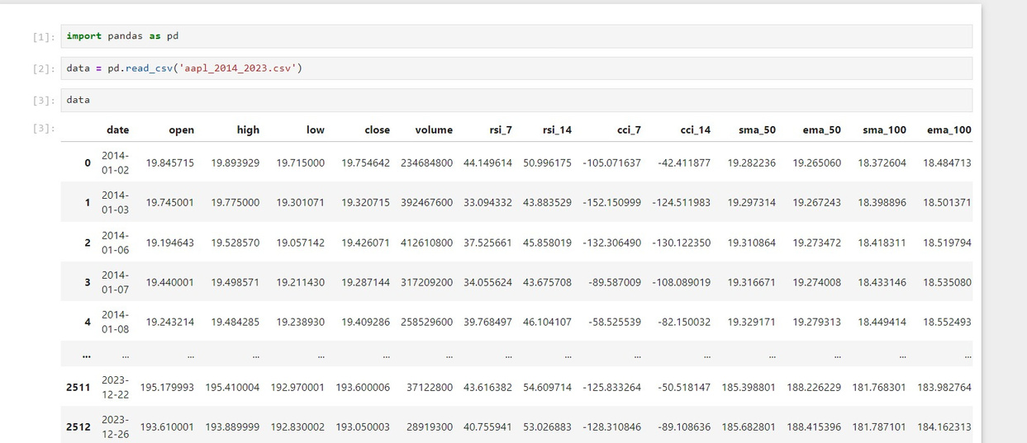
Implementation:-
Notes:
<number>

Slide 13
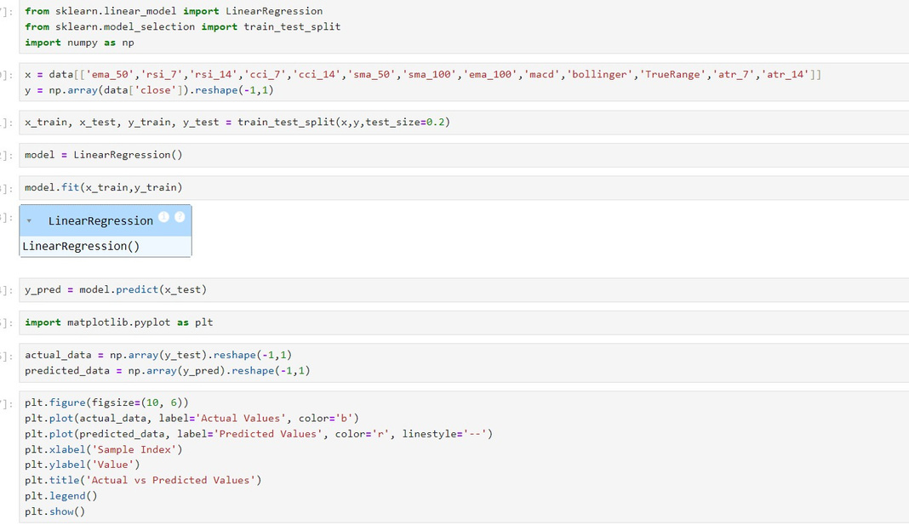

Slide 14
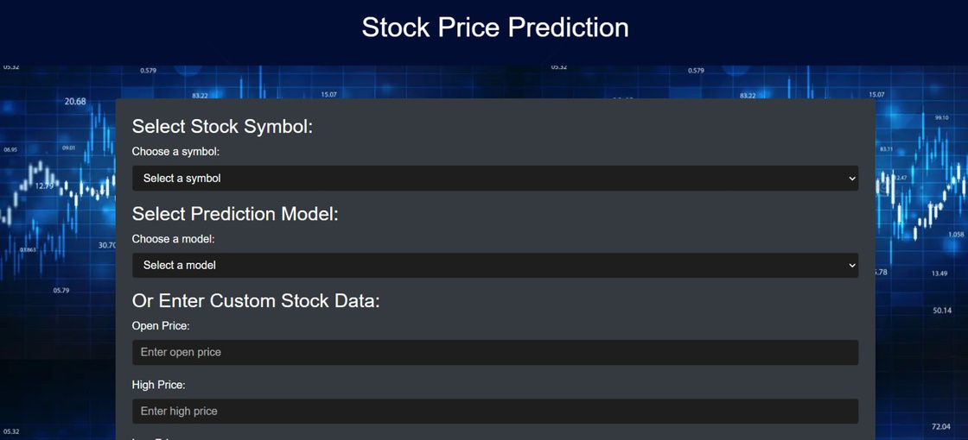

Slide 15
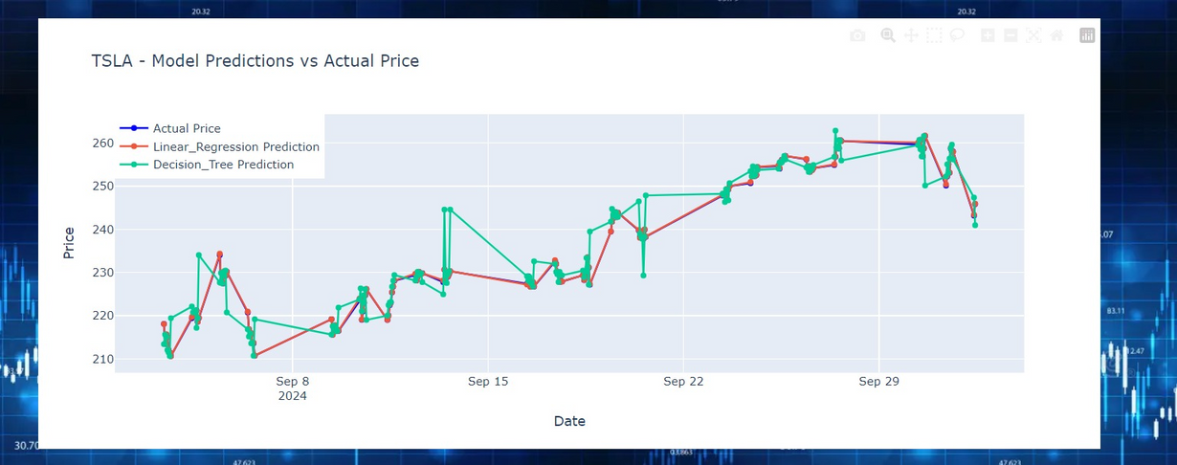

Slide 16

Conclusion
Project Progress: We have successfully completed our stock price prediction model, including data collection, preprocessing, and the initial design of the predictive system.
Key Learnings: So far, we have gained valuable experience in handling large datasets, feature engineering, and the basics of applying machine learning algorithms to financial data.
Next Steps: Moving forward, we will focus on fine-tuning the model, experimenting with various machine learning techniques, and thoroughly evaluating the model's performance to ensure its robustness and reliability.
Future Prospects: This project aims to provide insights into stock price trends, aiding in more informed financial decision-making.
Notes:
<number>

Slide 17
References
1. Stock Price Prediction using Machine Learning
Publisher: IEEE
Authors: B N Varaprasad; Ch. Kundan Kanth; G. Jeevan; Y.Kalyan
Chakravarti
Published in & by: 2022 International Conference on Electronics and
Renewable Systems (ICEARS)
2. Stock Market Prediction using Supervised Machine Learning Techniques
Publisher: IEEE
Published in & by: 2020 IEEE Asia-Pacific Conference on Computer
Science and Data Engineering (CSDE)
Authors:Zaharaddeen Karami Lawal; Hayati Yassin; Rufai Yusuf
Zakari
Notes:
<number>

Slide 18
References
3. Stock Market Prediction using Machine Learning Techniques
Publisher: IEEE
Published in & by: 2023 International Conference on Power,
Instrumentation, Control and Computing (PICC)
Authors: Aditi Gupta; Akansha; Khushboo Joshi; Madhu Patel;
.
4. Stock market prediction
Publisher: IEEE
Published in & by: 2015 19th International Conference on System Theory,
Control and Computing (ICSTCC)
Author: Radu Iacomin
Notes:
<number>

Slide 19
Thank
You...!!
Notes:
<number>

